Slide 1



Schedule Strategist v0.3
View in Power BI
Last data refresh:
24/01/2025 18:56:23 UTC
Downloaded at:
26/01/2025 00:18:24 UTC

Slide 2
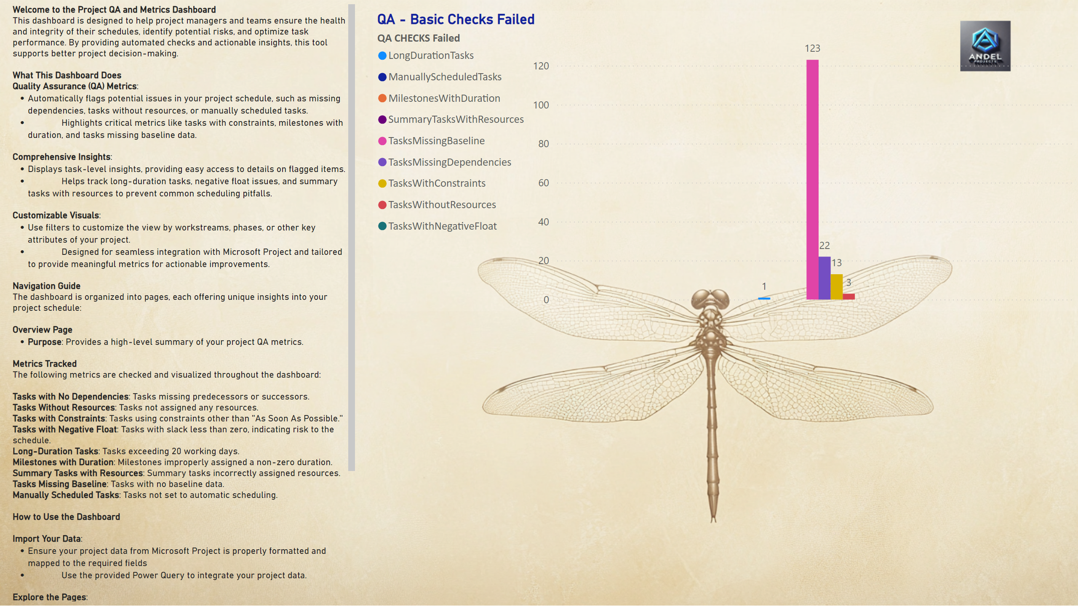
Overview
Notes:
textbox
No alt text provided
QA - Basic Checks Failed
No alt text provided

Slide 3
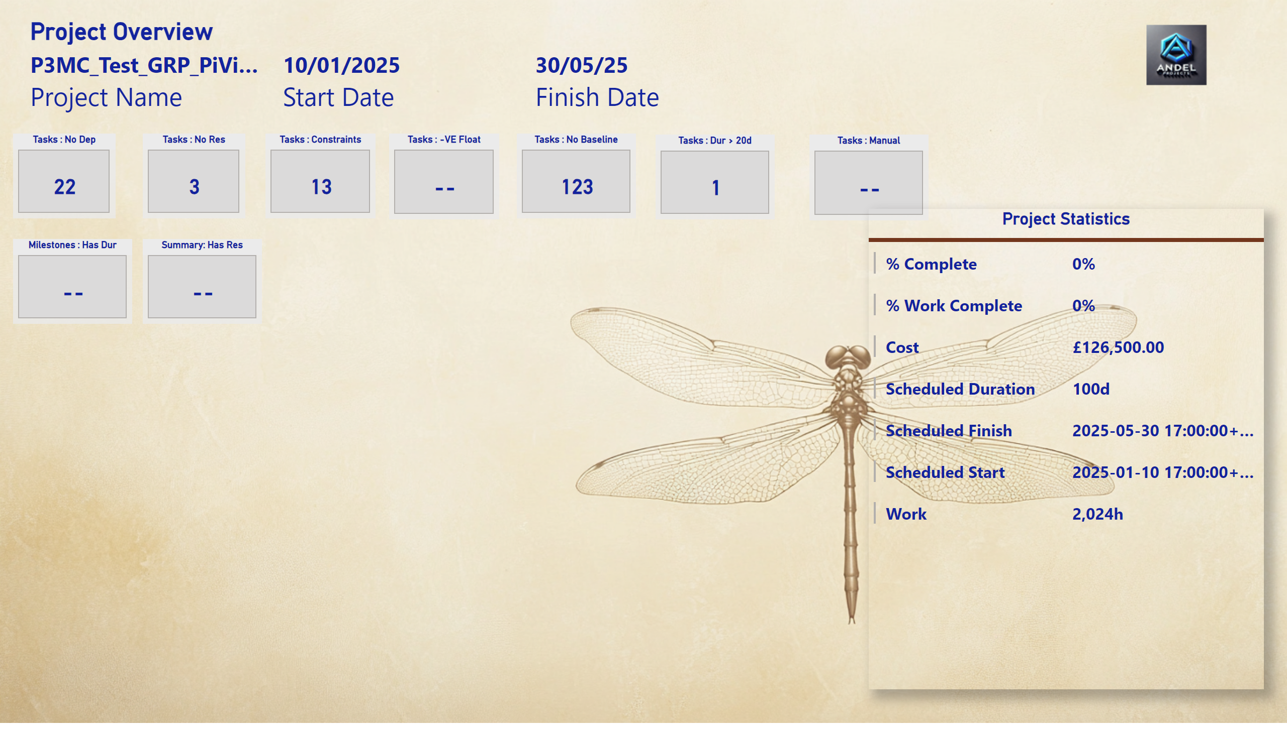
QA Dashboard - Basic
Notes:
Tasks : No Baseline
No alt text provided
Tasks : No Dep
No alt text provided
Tasks : No Res
No alt text provided
Tasks : Constraints
No alt text provided
Tasks : -VE Float
No alt text provided
Milestones : Has Dur
No alt text provided
Summary: Has Res
No alt text provided
Tasks : Dur > 20d
No alt text provided
Tasks : Manual
No alt text provided
Project Overview
No alt text provided
Project Statistics
No alt text provided

Slide 4
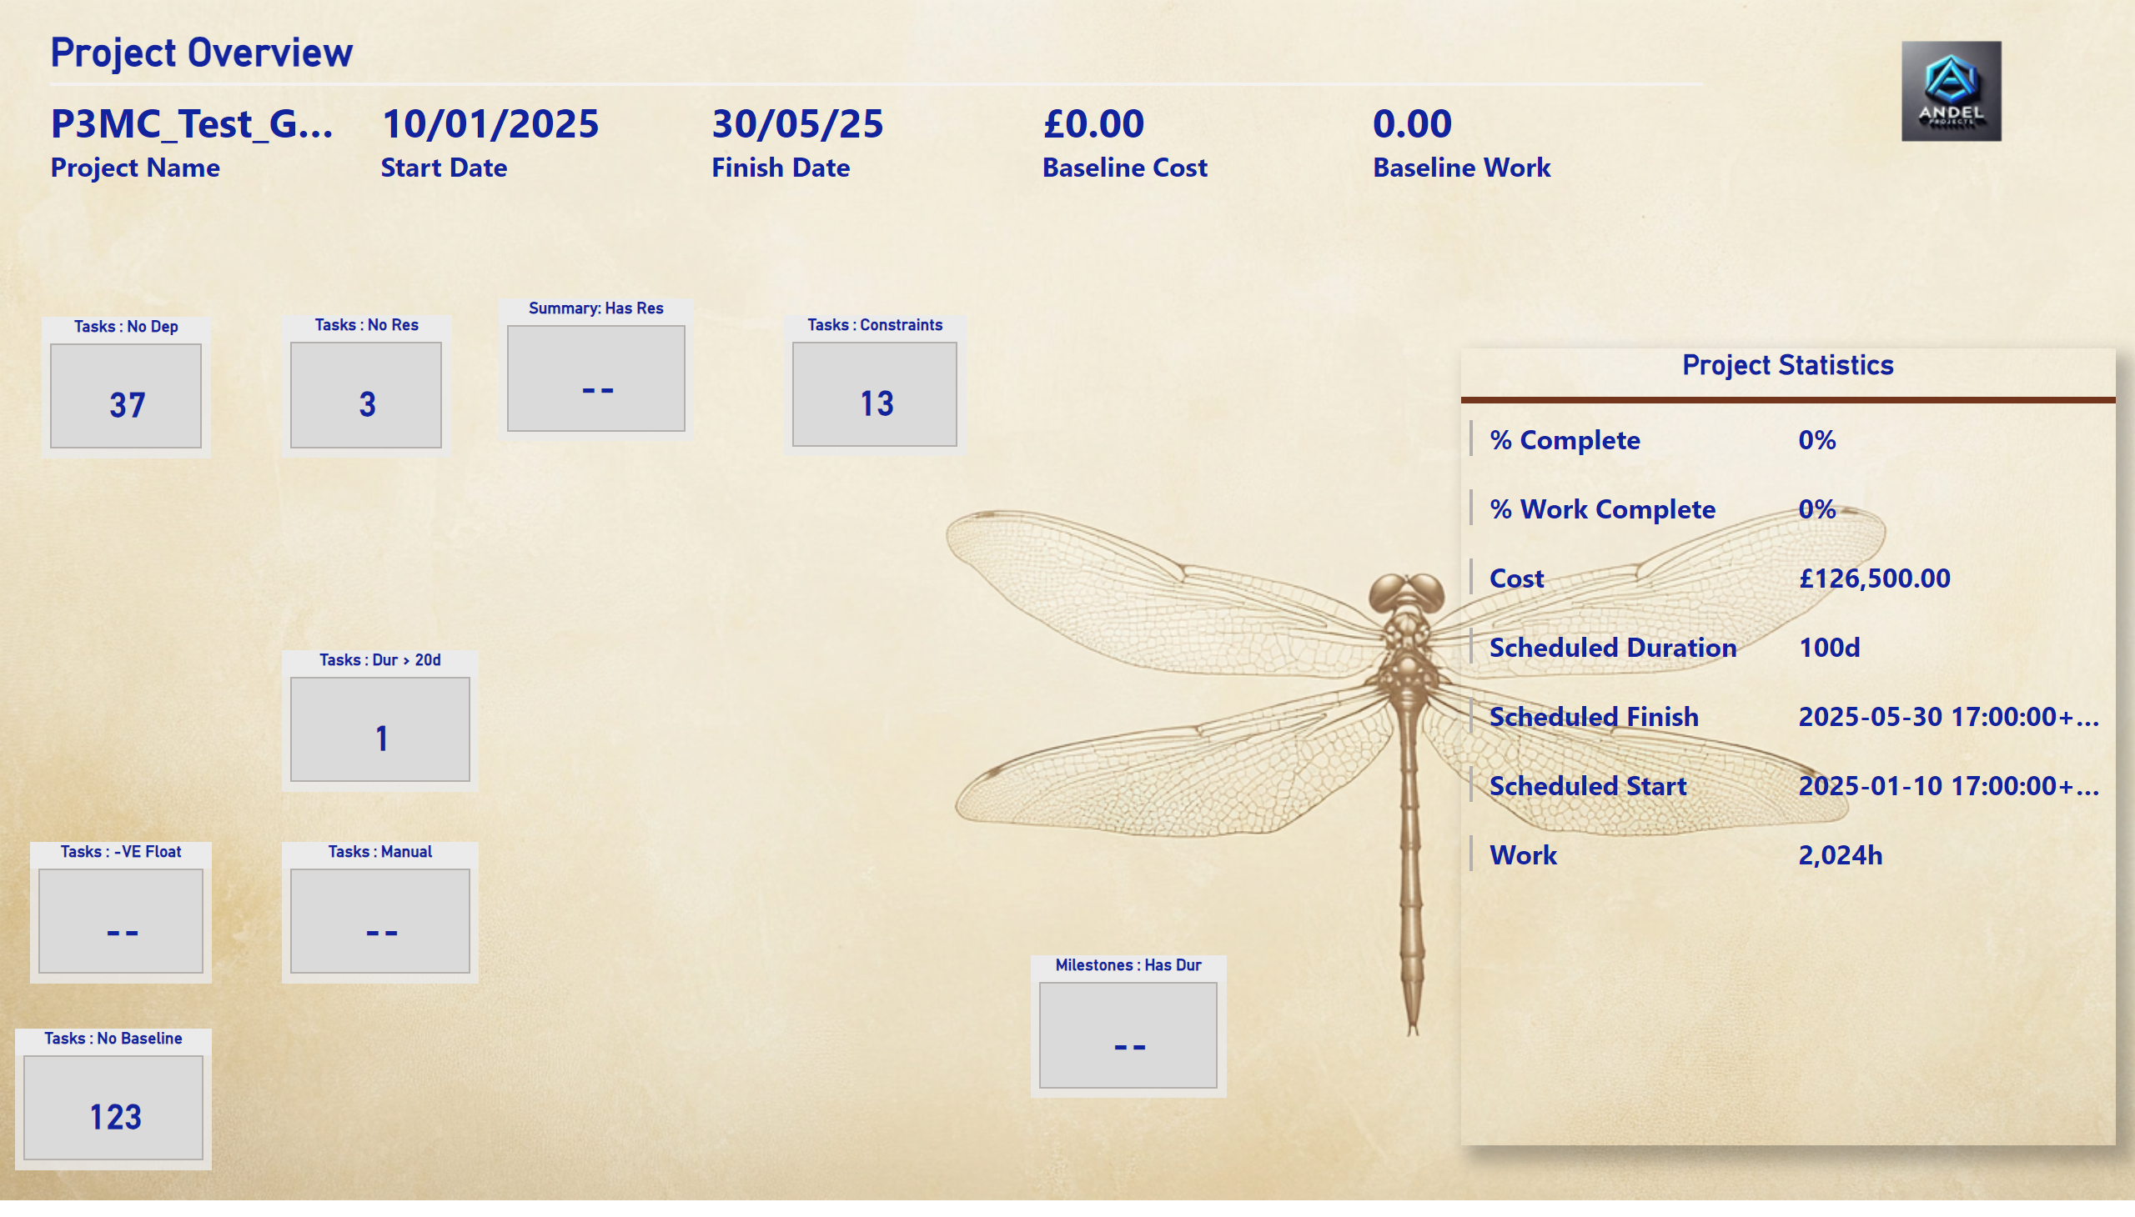
QA Dashboard - Advanced
Notes:
Tasks : No Baseline
No alt text provided
Tasks : No Dep
No alt text provided
Tasks : No Res
No alt text provided
Tasks : Constraints
No alt text provided
Tasks : -VE Float
No alt text provided
Milestones : Has Dur
No alt text provided
Summary: Has Res
No alt text provided
Tasks : Dur > 20d
No alt text provided
Tasks : Manual
No alt text provided
Project Overview
No alt text provided
Project Statistics
No alt text provided

Slide 5
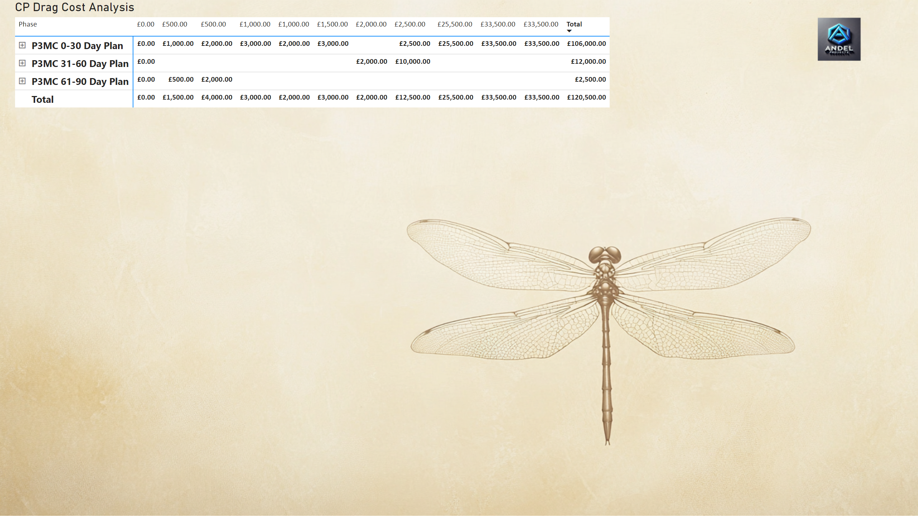
CP DRAG -Benefits by Critical Path Task
Notes:
CP Drag Cost Analysis
No alt text provided

Slide 6
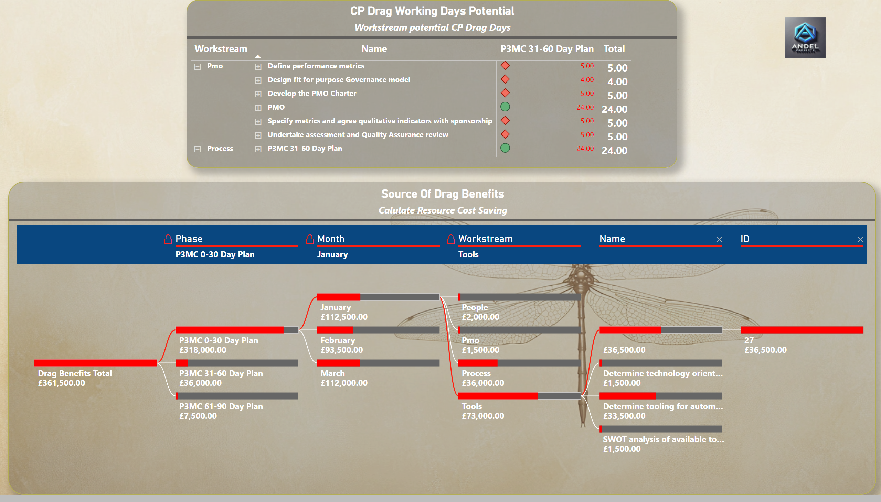
CP DRAG - Benefits Potential Discovery
Notes:
pivotTable
No alt text provided
Source Of Drag Benefits
No alt text provided
CP Drag Working Days Potential
No alt text provided

Slide 7
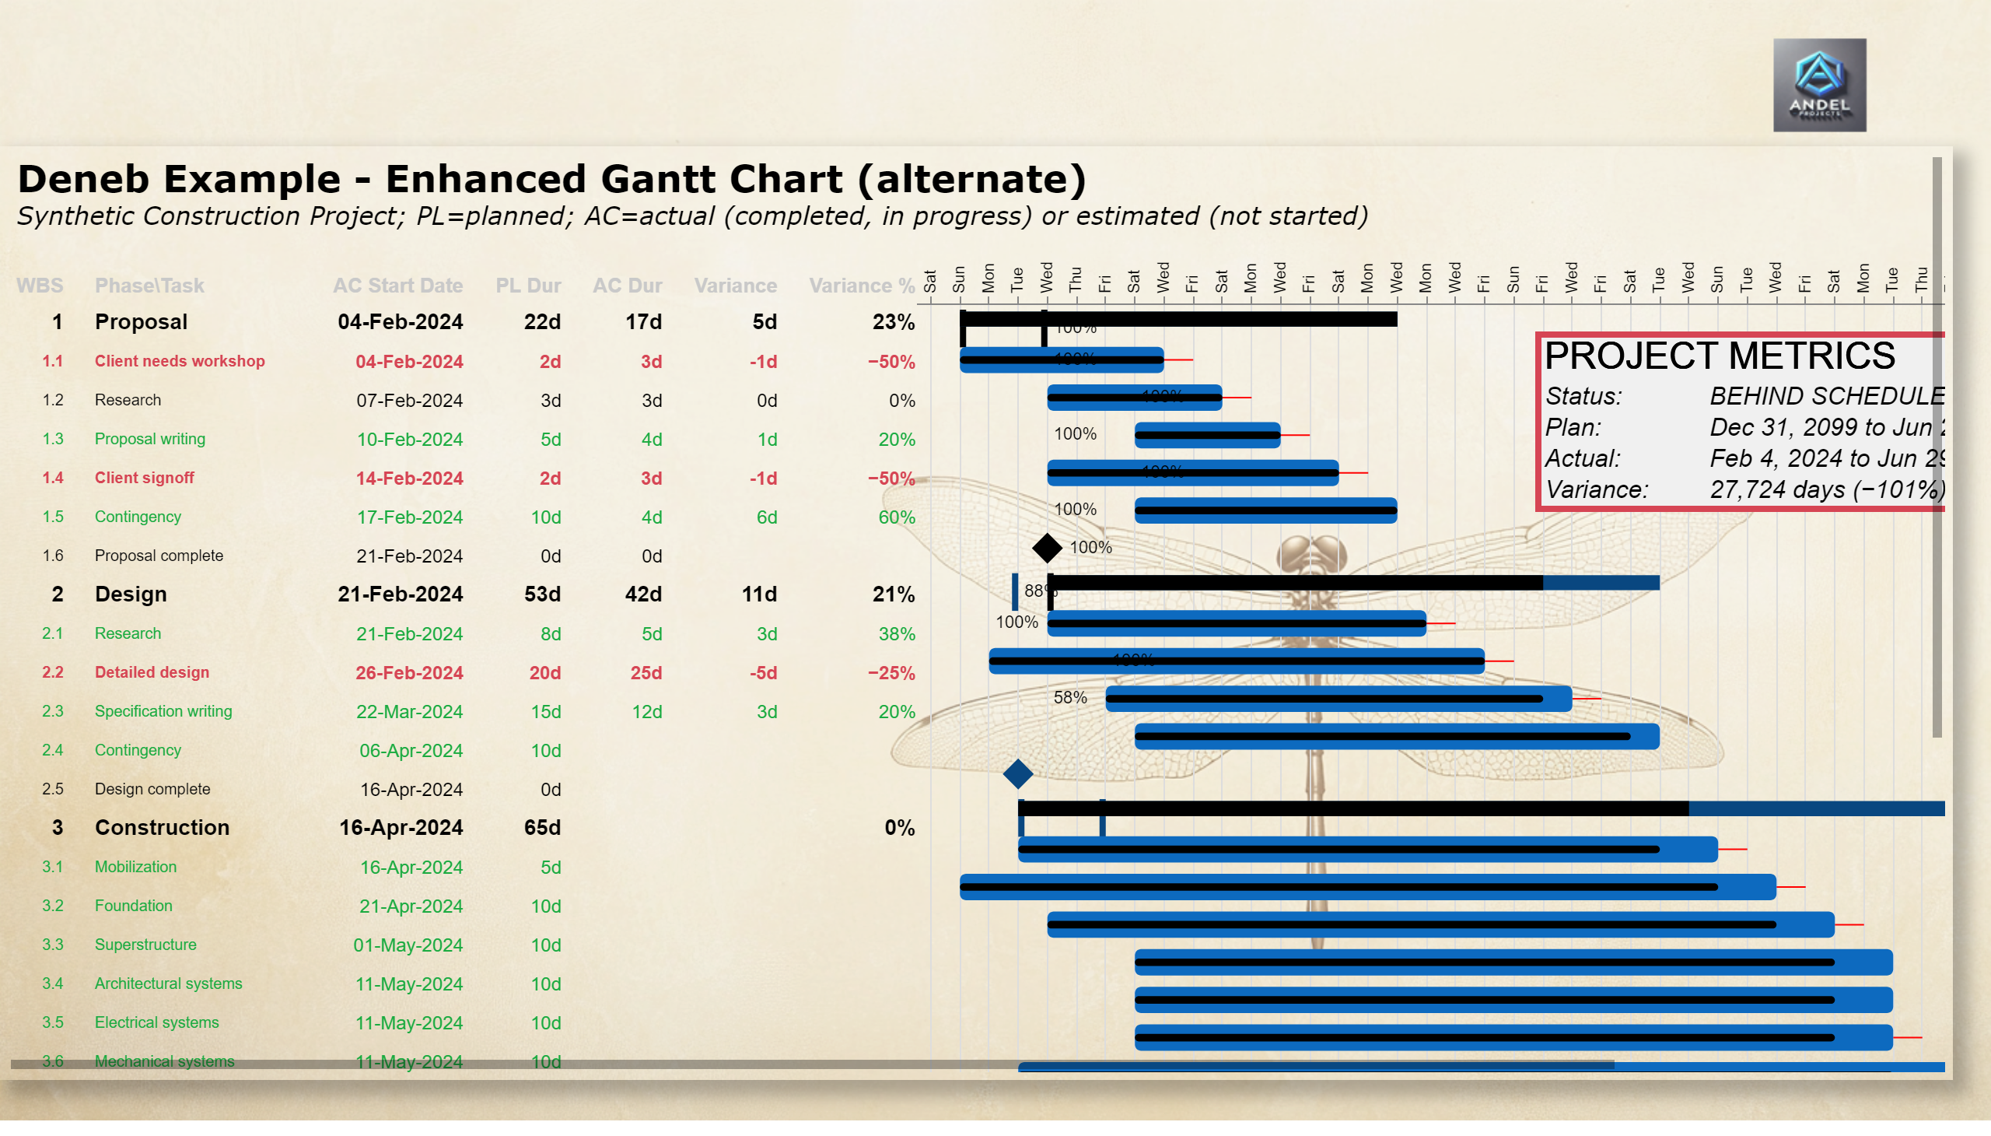
CP DRAG - Critical Path Gantt
Notes:
deneb7E15AEF80B9E4D4F8E12924291ECE89A
No alt text provided

